Slide 1


Search for an exotic Higgs boson decay to two pseudoscalar bosons with a four photon final state Oral Candidacy Proposal December 13, 2023
Sergi Castells
Advisors: Colin Jessop and Nancy Marinelli

Slide 2
Outline
The Standard Model and Beyond
LHC and CMS
Introduction to Analysis
Sample Generation
Event Selection
Statistical Analysis
Advancements on Previous Studies
Summary
Notes:
Introduction – what am I doing? Basic why is it interesting?
The Standard Model and Beyond – theory stuff
LHC and CMS – also mention service work here briefly
Sample Generation – signal MC and event mixing part
Event Selection – cuts, BDT, categorization
Statistical Analysis – signal modelling + note on background fits
Advancements on Previous Studies – exactly what it sounds like
Summary – put everything together for questions
REMEMBER TO INCLUDE PLOTS!!!!!!!

Slide 3
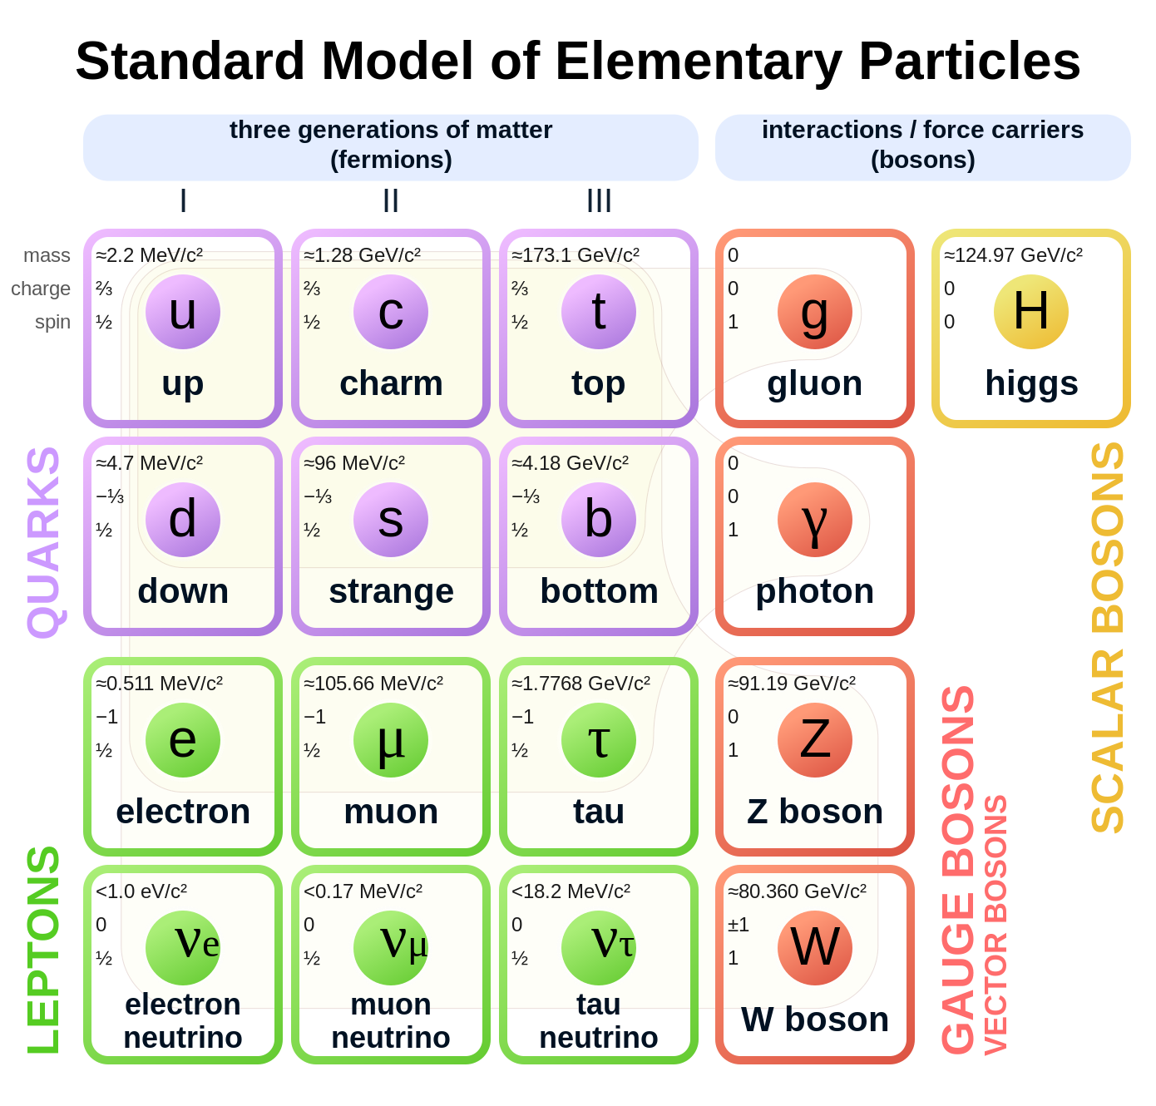
The Standard Model
Most complete model of particle physics that describes all known elementary particles
Describes three fundamental interactions:
Weak
Strong
Electromagnetic
Rich Higgs sector phenomenology:
Higgs mechanism yields gauge boson masses
Higgs VEV & Yukawa couplings yield other particle masses
Beyond the Standard Model physics can remedy its shortcomings and predict interesting, new physics

Slide 4
Outline
The Standard Model and Beyond
LHC and CMS
Introduction to Analysis
Sample Generation
Event Selection
Statistical Analysis
Advancements on Previous Studies
Summary
Notes:
Introduction – what am I doing? Basic why is it interesting?
The Standard Model and Beyond – theory stuff
LHC and CMS – also mention service work here briefly
Sample Generation – signal MC and event mixing part
Event Selection – cuts, BDT, categorization
Statistical Analysis – signal modelling + note on background fits
Advancements on Previous Studies – exactly what it sounds like
Summary – put everything together for questions
REMEMBER TO INCLUDE PLOTS!!!!!!!

Slide 5
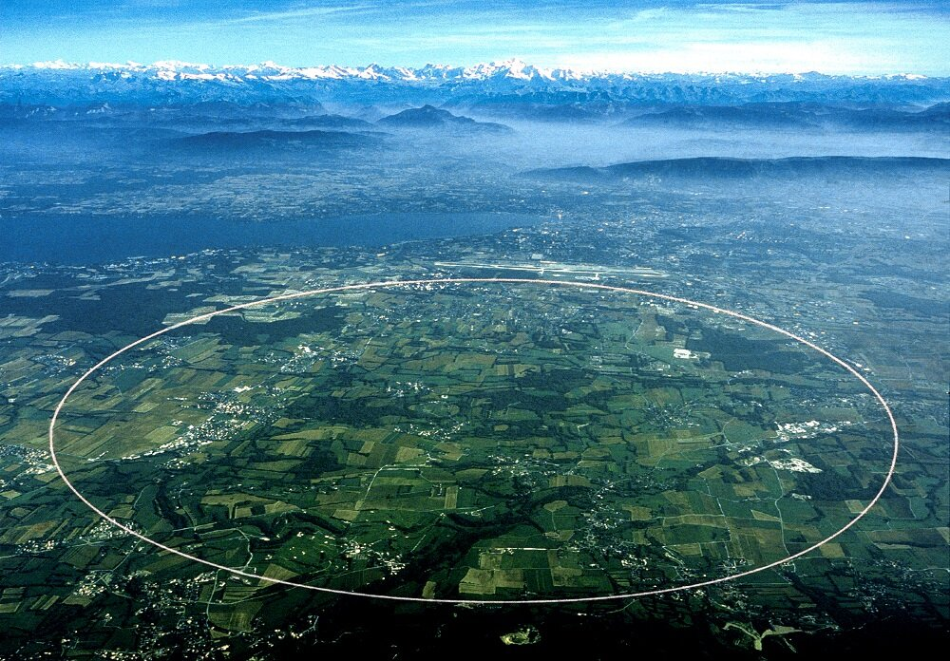
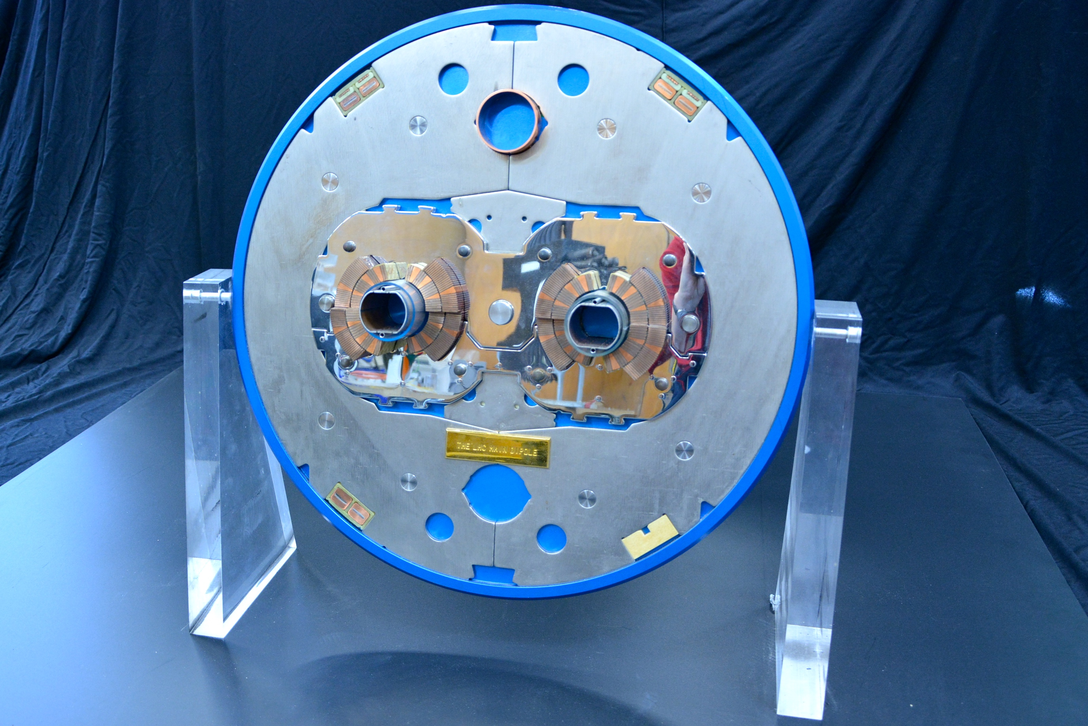
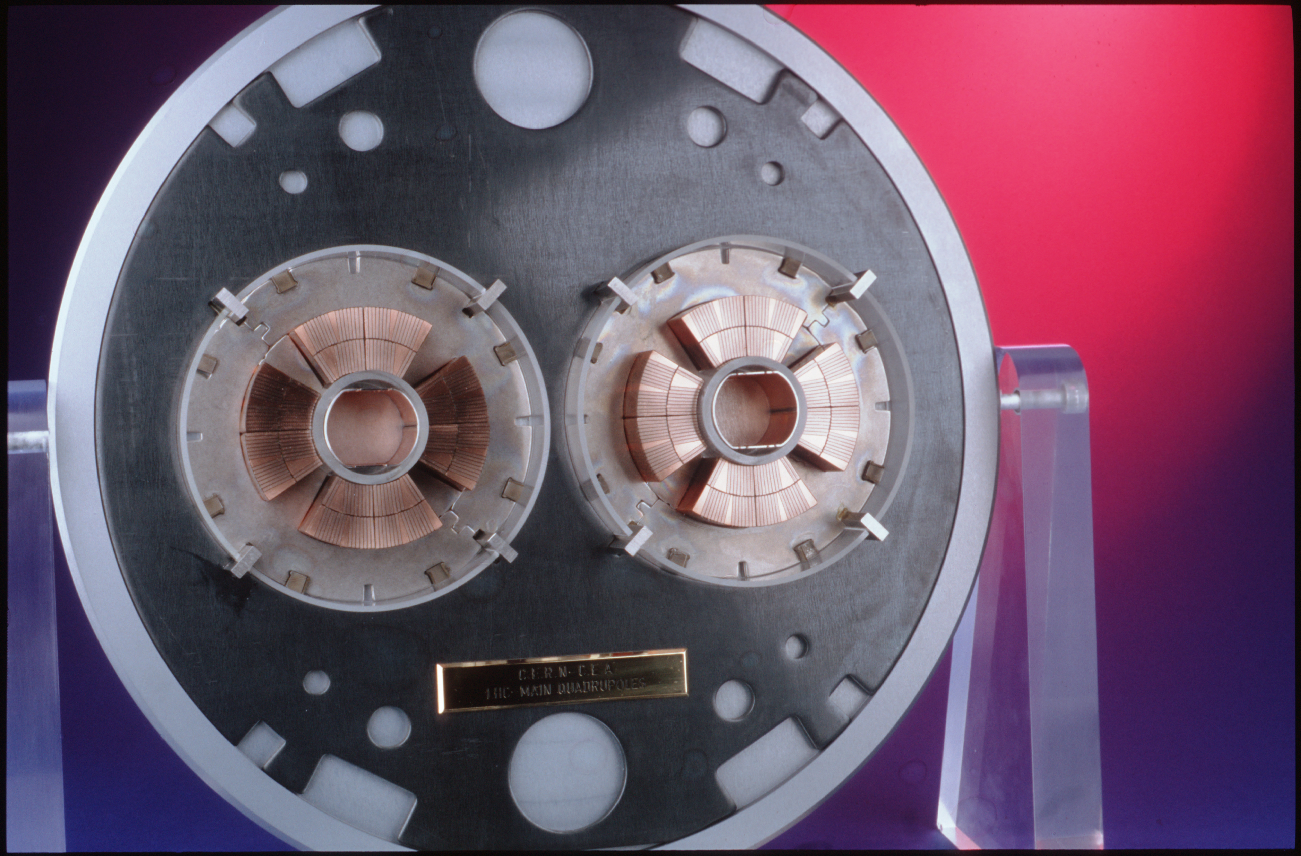
The Large Hadron Collider (LHC)
The LHC is the world’s largest particle accelerator, located on the border of France and Switzerland.
It is 27 km in circumference and operates at a center-of-mass energy of 13.6 TeV.
Superconducting dipole and quadrupole magnets bend and squeeze the proton beams, respectively. Additional multipole magnets are used to correct the beam.
The LHC can achieve a nominal instantaneous luminosity of 10³³ cm⁻² s⁻¹.
Four detectors along beamline:
General purpose: CMS and ATLAS
Specialized: ALICE and LHCb
Above: Slice of LHC dipole magnets.
Below: Slice of LHC quadrupole magnets

Slide 6
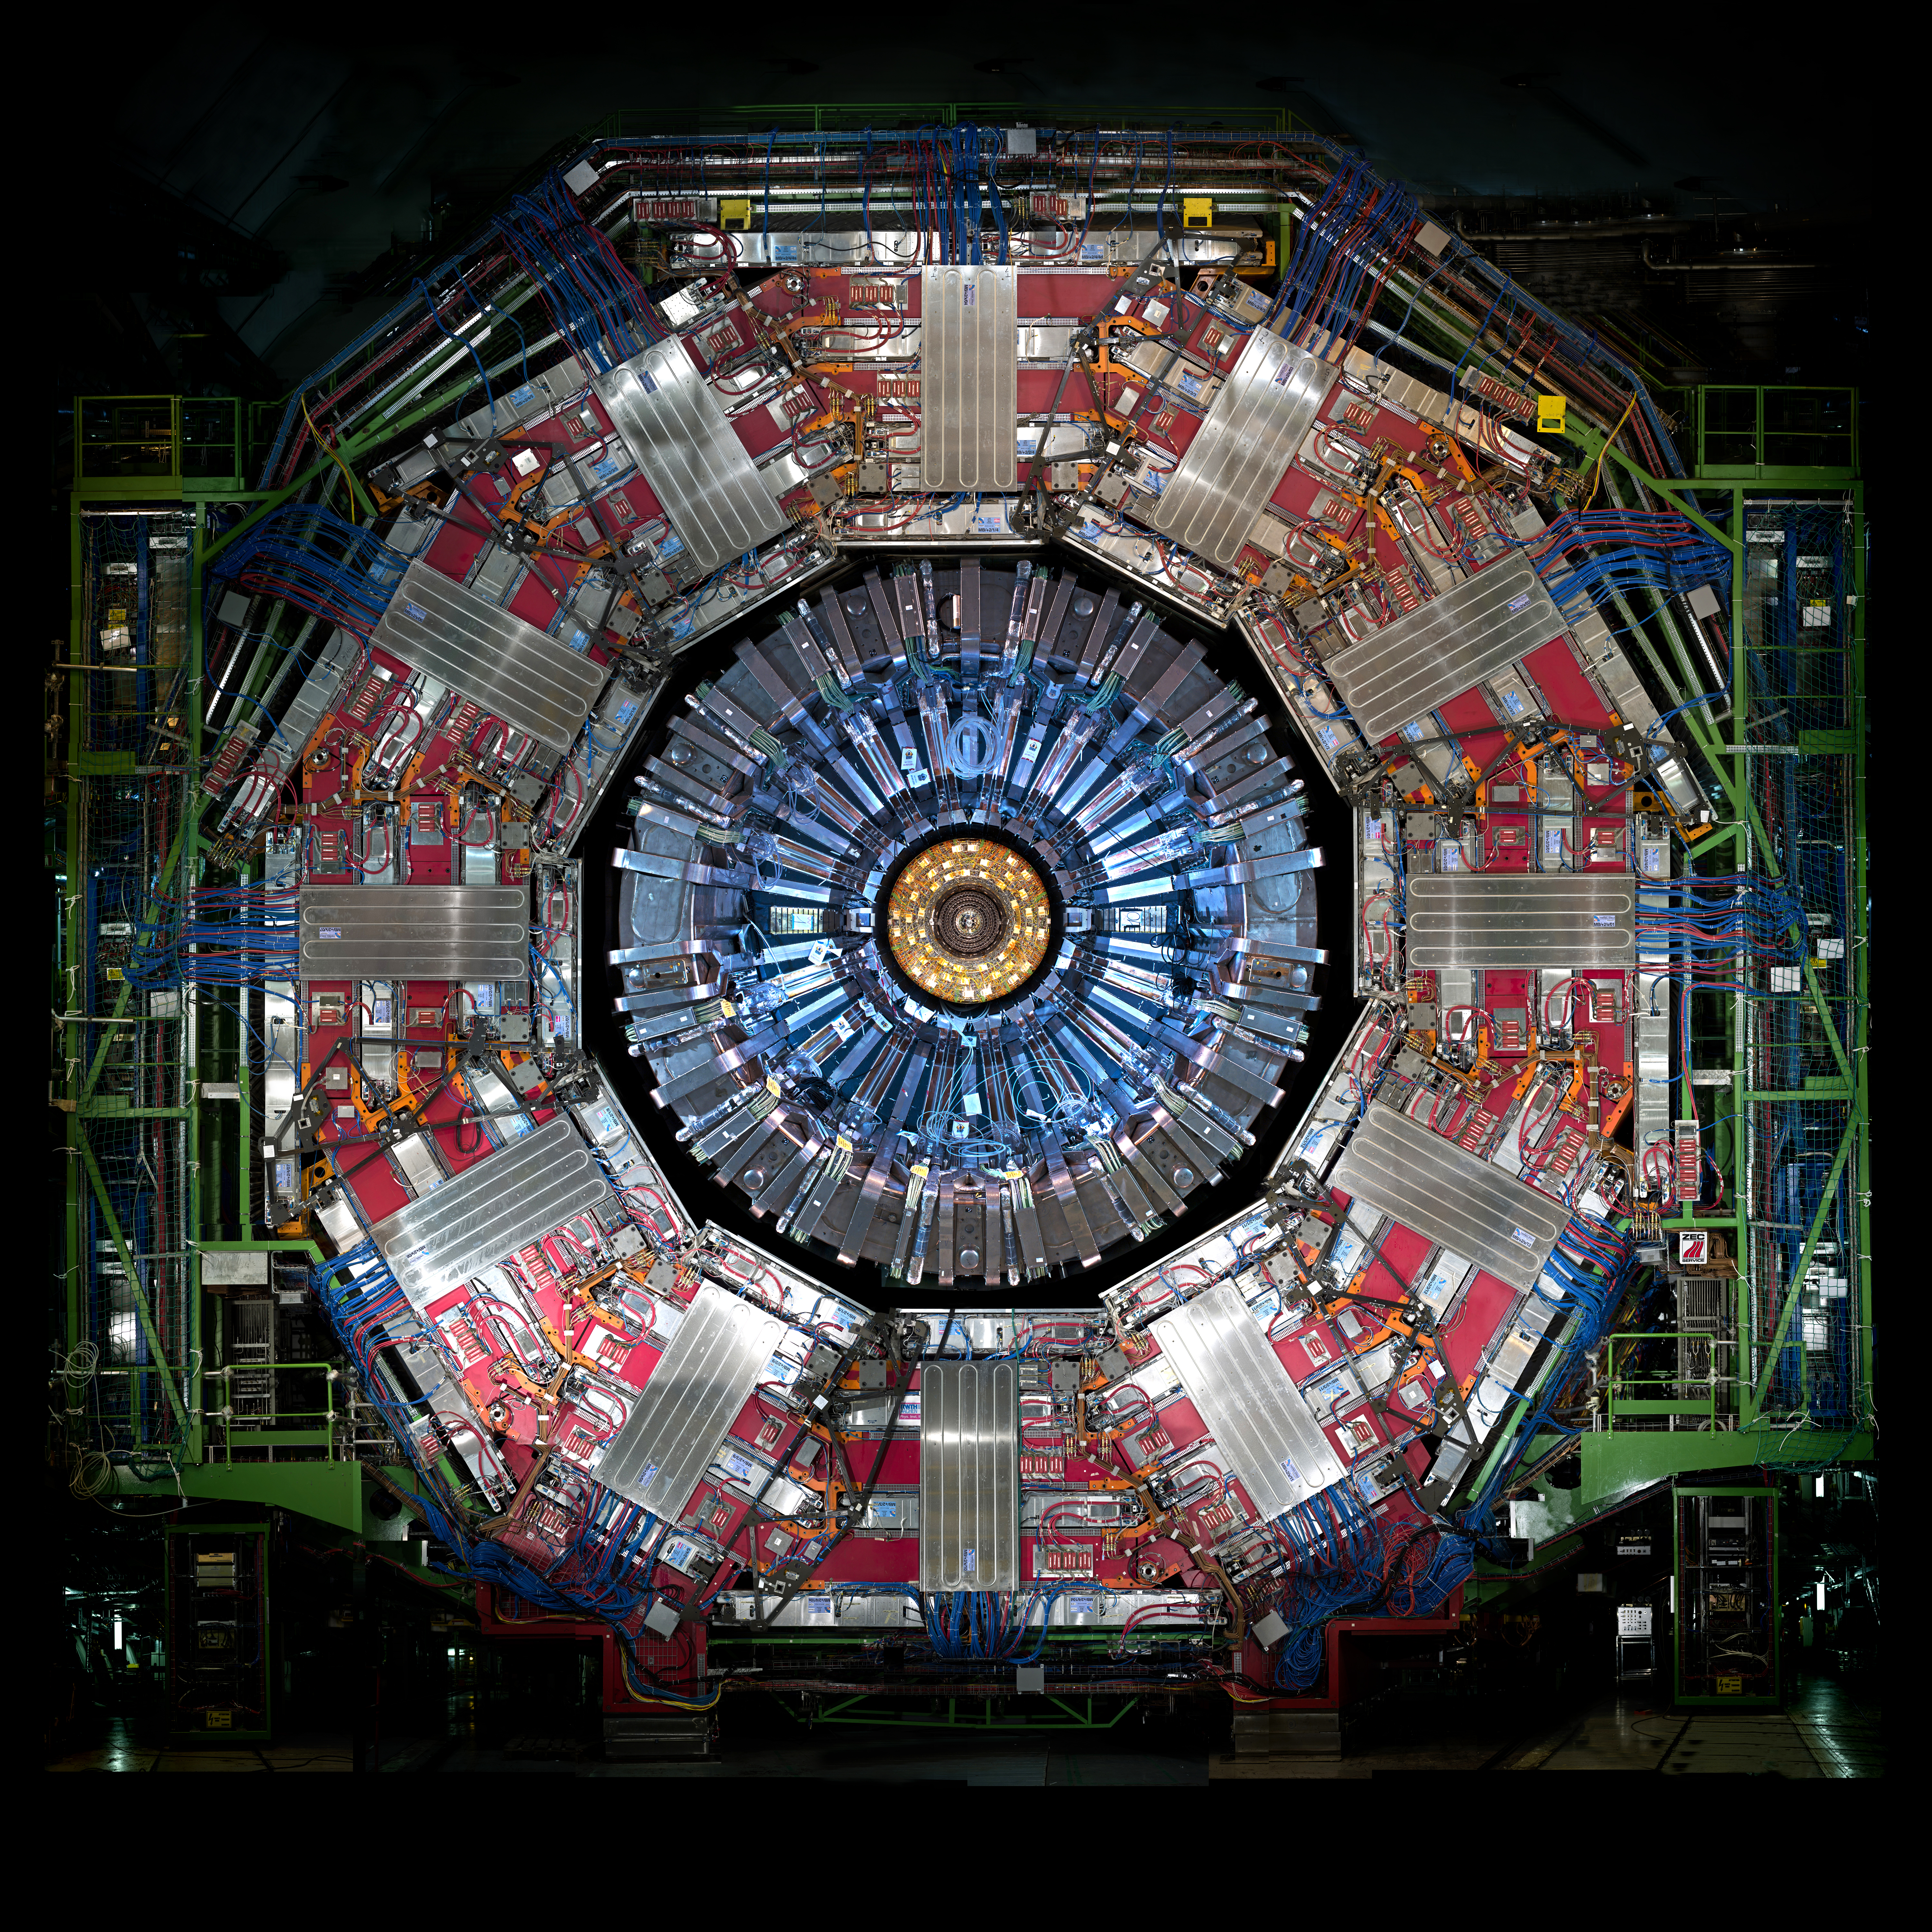
Compact Muon Solenoid (CMS)
Silicon tracker
Solid-state pixel and strip detectors
Detects charged particle tracks
Electromagnetic calorimeter (ECAL)
Homogenous detector
Consists of 75,000 PbWO₄ crystals
Stops and detects electromagnetically charged particle showers
Hadronic calorimeter (HCAL)
Sampling calorimeter
Layers of plastic scintillator and brass absorbers
Stops and detects neutral and charged hadrons
Solenoid Magnet
Bends charged particles to measure momentum
Muon chambers
Stops and detects muons
Notes:
Sampling vs Homogenous are two the different types of calorimeters. Sampling is like the HCAL where two materials alternate to cause showers and measure the decays. Homogeneous calorimeters are made of one material that both causes and measures the particle shower (e.g. ECAL).

Slide 7
Outline
The Standard Model and Beyond
LHC and CMS
Introduction to Analysis
Sample Generation
Event Selection
Statistical Analysis
Advancements on Previous Studies
Summary
Notes:
Introduction – what am I doing? Basic why is it interesting?
The Standard Model and Beyond – theory stuff
LHC and CMS – also mention service work here briefly
Sample Generation – signal MC and event mixing part
Event Selection – cuts, BDT, categorization
Statistical Analysis – signal modelling + note on background fits
Advancements on Previous Studies – exactly what it sounds like
Summary – put everything together for questions
REMEMBER TO INCLUDE PLOTS!!!!!!!

Slide 8
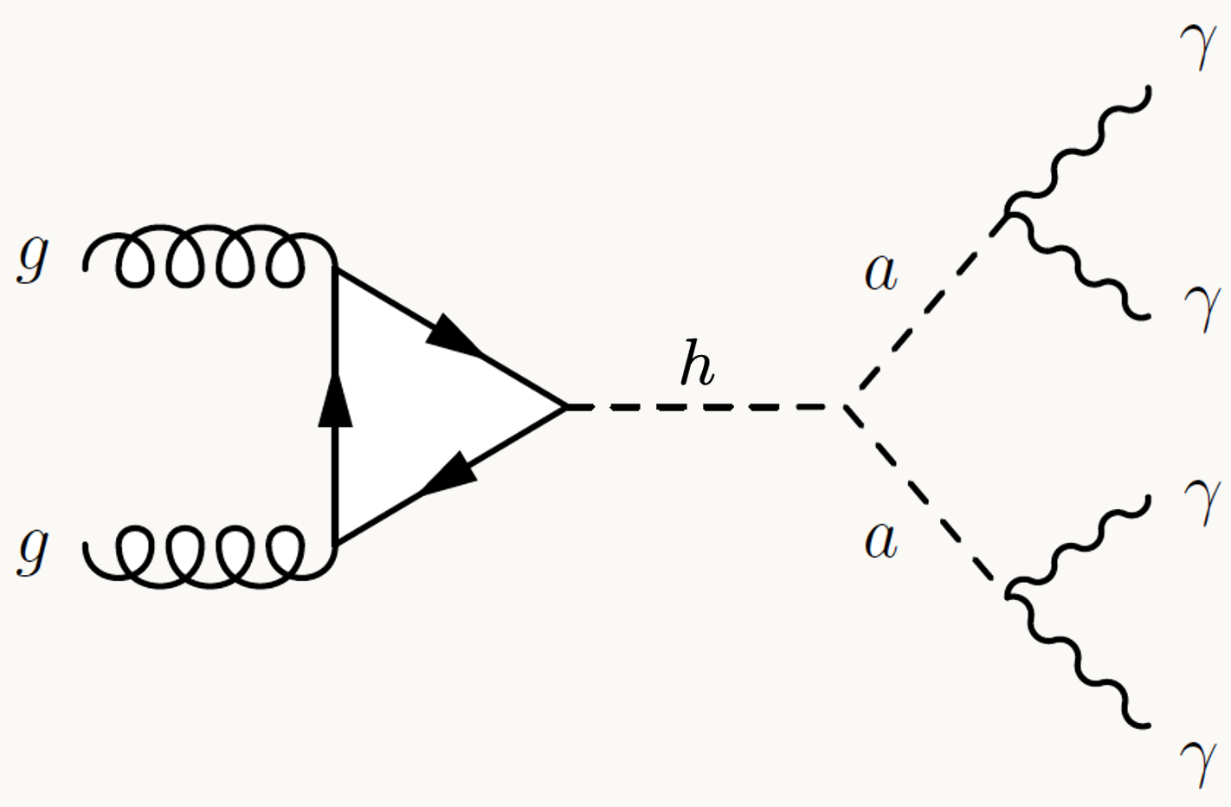
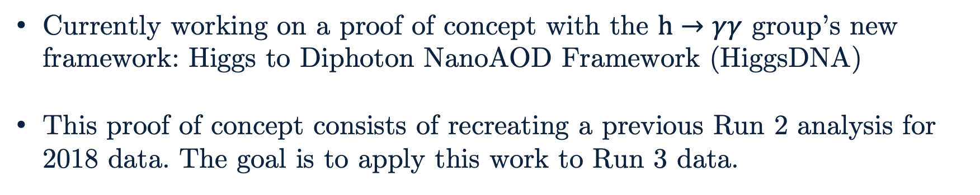
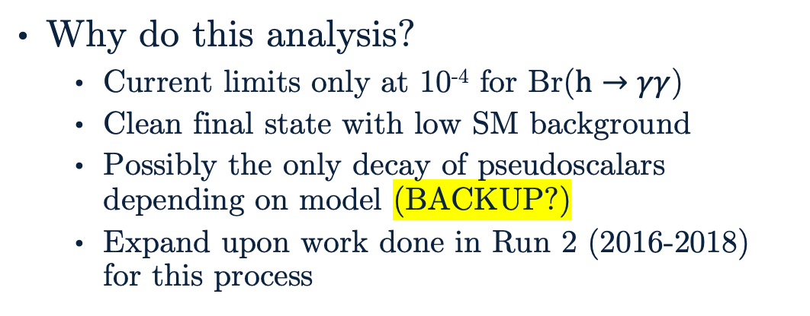
Introduction to Analysis
Why do this analysis?
Current limits only at 10⁻⁴ for Br($h→γγ$)
Clean final state with low SM background
Possibly the only decay of pseudoscalars depending on model (BACKUP?)
Expand upon work done in Run 2 (2016-2018) for this process
Currently working on a proof of concept with the $h→γγ$ group’s new framework: Higgs to Diphoton NanoAOD Framework (HiggsDNA)
This proof of concept consists of recreating a previous Run 2 analysis for 2018 data. The goal is to apply this work to Run 3 data.

Slide 9
Outline
The Standard Model and Beyond
LHC and CMS
Introduction to Analysis
Sample Generation
Event Selection
Statistical Analysis
Advancements on Previous Studies
Summary
Notes:
Introduction – what am I doing? Basic why is it interesting?
The Standard Model and Beyond – theory stuff
LHC and CMS – also mention service work here briefly
Sample Generation – signal MC and event mixing part
Event Selection – cuts, BDT, categorization
Statistical Analysis – signal modelling + note on background fits
Advancements on Previous Studies – exactly what it sounds like
Summary – put everything together for questions
REMEMBER TO INCLUDE PLOTS!!!!!!!

Slide 10
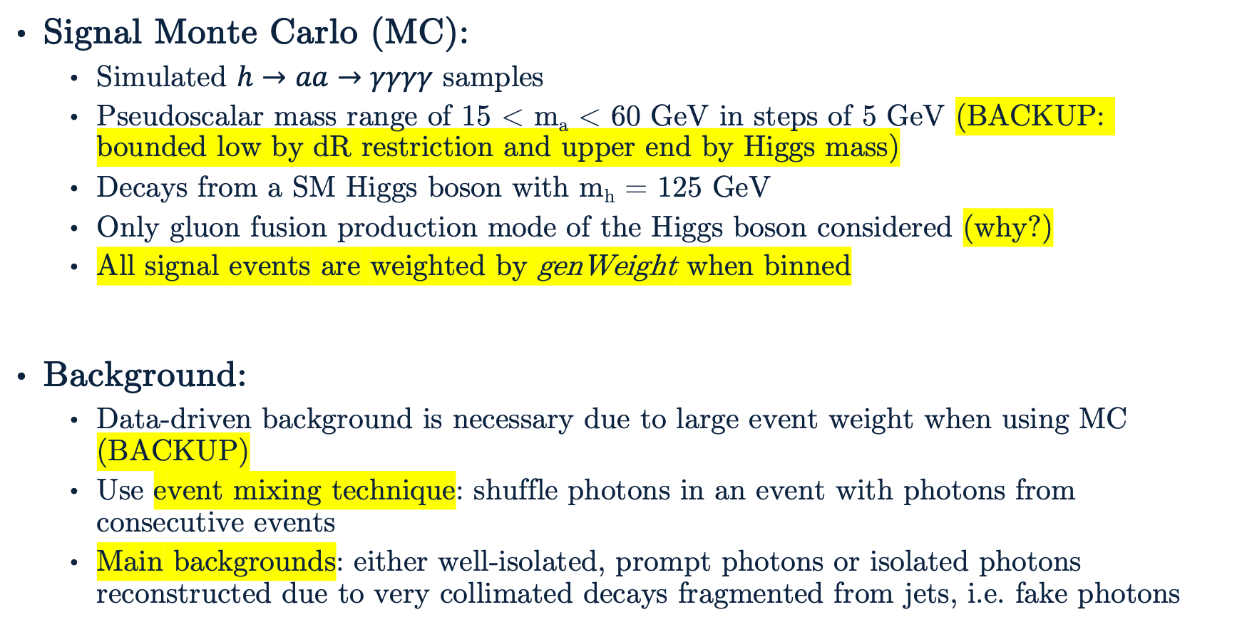
Sample Generation
Signal Monte Carlo (MC):
Simulated $h→aa→γγγγ$ samples
Pseudoscalar mass range of 15 < m_{a} < 60 GeV in steps of 5 GeV (BACKUP: bounded low by dR restriction and upper end by Higgs mass)
Decays from a SM Higgs boson with m_{h} = 125 GeV
Only gluon fusion production mode of the Higgs boson considered (why?)
All signal events are weighted by genWeight when binned
Background:
Data-driven background is necessary due to large event weight when using MC (BACKUP)
Use event mixing technique: shuffle photons in an event with photons from consecutive events
Main backgrounds: either well-isolated, prompt photons or isolated photons reconstructed due to very collimated decays fragmented from jets, i.e. fake photons

Slide 11
Outline
The Standard Model and Beyond
LHC and CMS
Introduction to Analysis
Sample Generation
Event Selection
Statistical Analysis
Advancements on Previous Studies
Summary
Notes:
Introduction – what am I doing? Basic why is it interesting?
The Standard Model and Beyond – theory stuff
LHC and CMS – also mention service work here briefly
Sample Generation – signal MC and event mixing part
Event Selection – cuts, BDT, categorization
Statistical Analysis – signal modelling + note on background fits
Advancements on Previous Studies – exactly what it sounds like
Summary – put everything together for questions
REMEMBER TO INCLUDE PLOTS!!!!!!!

Slide 12
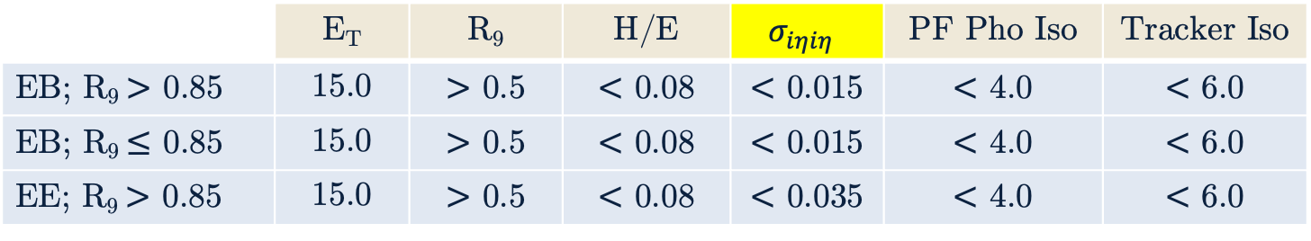
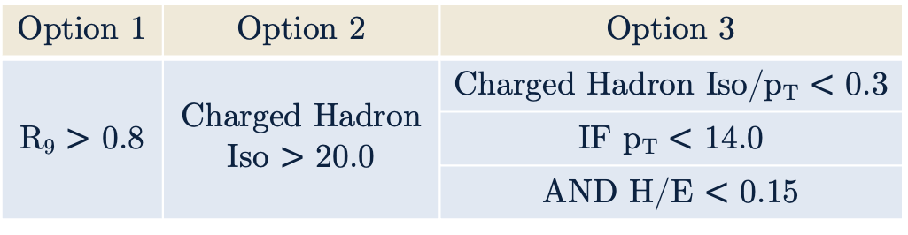
Pre-selections
 | E_{T} | R₉ | H/E | $$σ_{iηiη}$$ | PF Pho Iso | Tracker Iso
EB; R₉ $>$ 0.85 | 15.0 | $>$ 0.5 | $<$ 0.08 | $<$ 0.015 | $<$ 4.0 | $<$ 6.0
EB; R₉ $≤$ 0.85 | 15.0 | $>$ 0.5 | $<$ 0.08 | $<$ 0.015 | $<$ 4.0 | $<$ 6.0
EE; R₉ $>$ 0.85 | 15.0 | $>$ 0.5 | $<$ 0.08 | $<$ 0.035 | $<$ 4.0 | $<$ 6.0
HLT mimicking cuts are used to ensure a consistent phase space for the search.
HLT Path: HLT_Diphoton30_18R9IdL_AND_HE_AN_IsoCaloId_NoPixelVeto
Selections looser than the High Level Trigger (HLT) path are applied
Events must pass at least one of Option 1-3
Diphoton candidates require p_{T} > 30 GeV and p_{T} > 18 GeV for leading and subleading daughter photons
Require events have at least one diphoton candidate
Option 1 | Option 2 | Option 3
R₉ $>$ 0.8 | Charged Hadron Iso $>$ 20.0 | Charged Hadron Iso/p_{T} $<$ 0.3
 |  | IF p_{T} $<$ 14.0
 |  | AND H/E $<$ 0.15
Notes:
Important to note why each variable is used as a cut. Not important to mention the values beyond resolution(?) of photons below 15 GeV

Slide 13
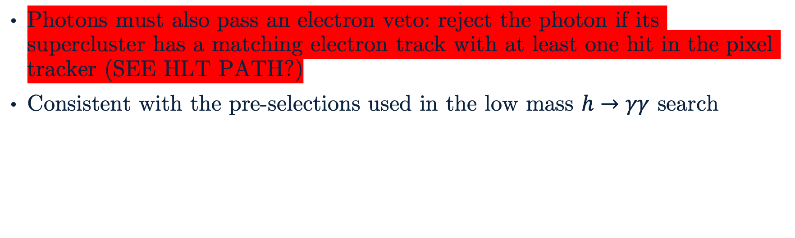
Pre-selections
Photons must also pass an electron veto: reject the photon if its supercluster has a matching electron track with at least one hit in the pixel tracker (SEE HLT PATH?)
Consistent with the pre-selections used in the low mass $h→γγ$ search

Slide 14
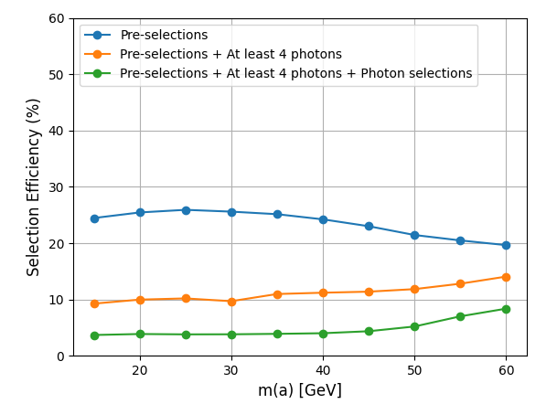
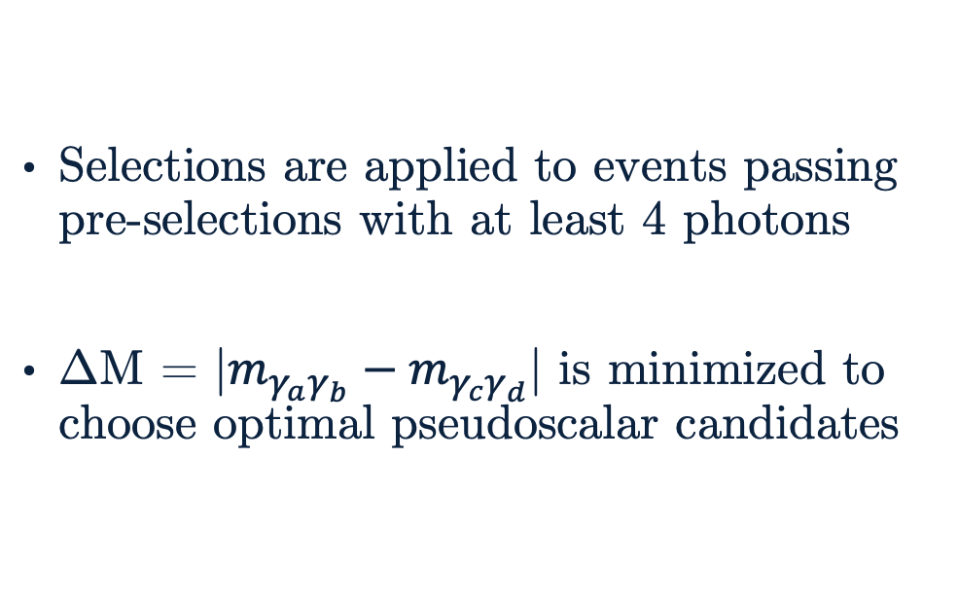
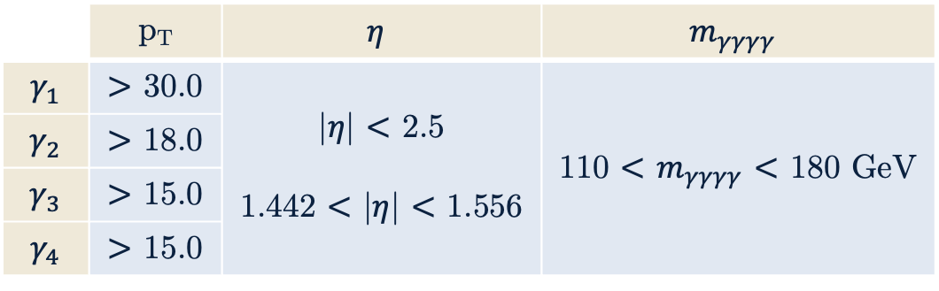
Photon Selections
Selections are applied to events passing pre-selections with at least 4 photons
ΔM = |$m_{γ_{a}γ_{b}}−m_{γ_{c}γ_{d}}$| is minimized to choose optimal pseudoscalar candidates
 | p_{T} | $$η$$ | $$m_{γγγγ}$$
$$γ_{1}$$ | $>$ 30.0 | |$η$| $<$ 2.5 1.442 $<$ |$η$| $<$ 1.556 | 110 $<$ $m_{γγγγ}$ $<$ 180 GeV
$$γ_{2}$$ | $>$ 18.0
$$γ_{3}$$ | $>$ 15.0
$$γ_{4}$$ | $>$ 15.0
Above: Efficiencies of selections at various stages. This should improve at higher mass points.

Slide 15
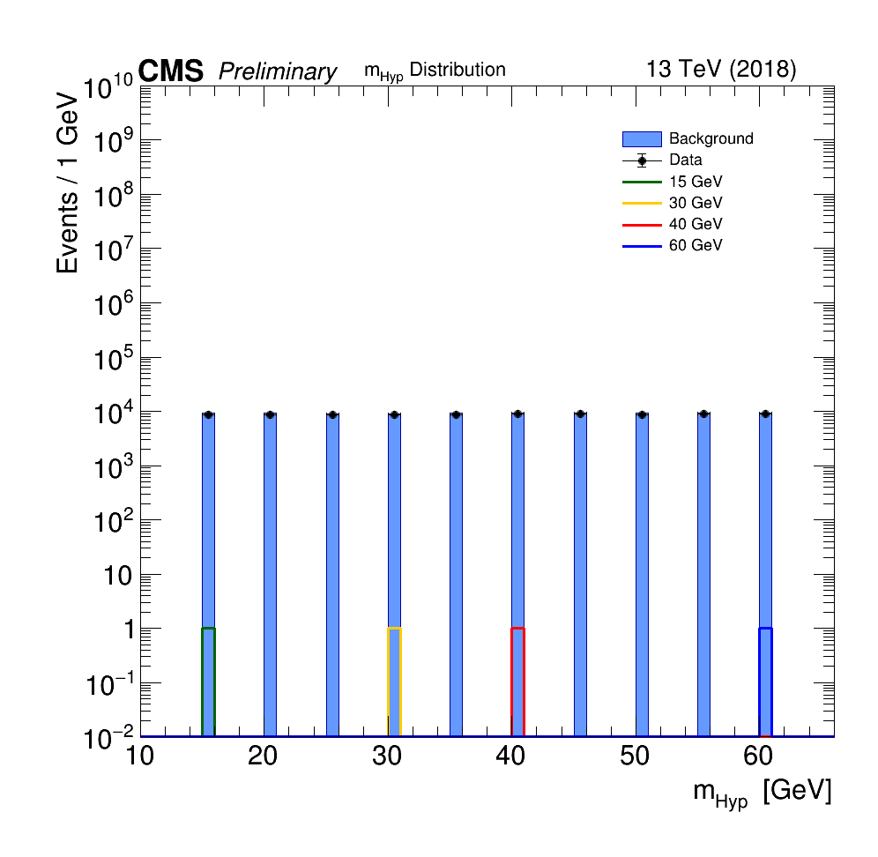
Event Selection BDT
What is a BDT?
Put stuff here…
Boosted Decision Tree
Need a BDT to better distinguish signal-like events from background-like events
One event selection BDT model is produced for all mass points, made possible by using a constructed variable: hypothesis mass or m_{Hyp}
Right: Distribution of m_{Hyp} for several nominal mass points, event mixed background, and data. m_{Hyp} has the associated value for a given pseudoscalar mass point for signal MC but a flat distribution for event mixed background and data, by construction.

Slide 16
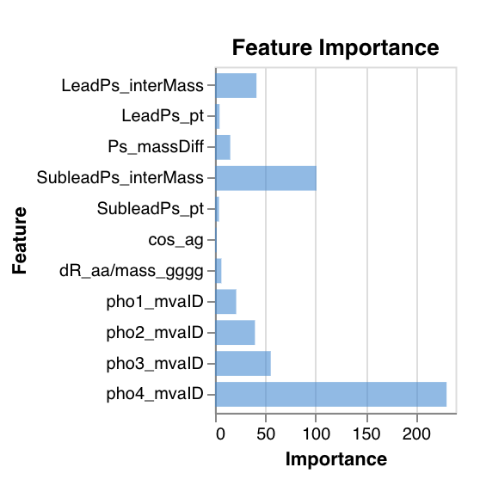
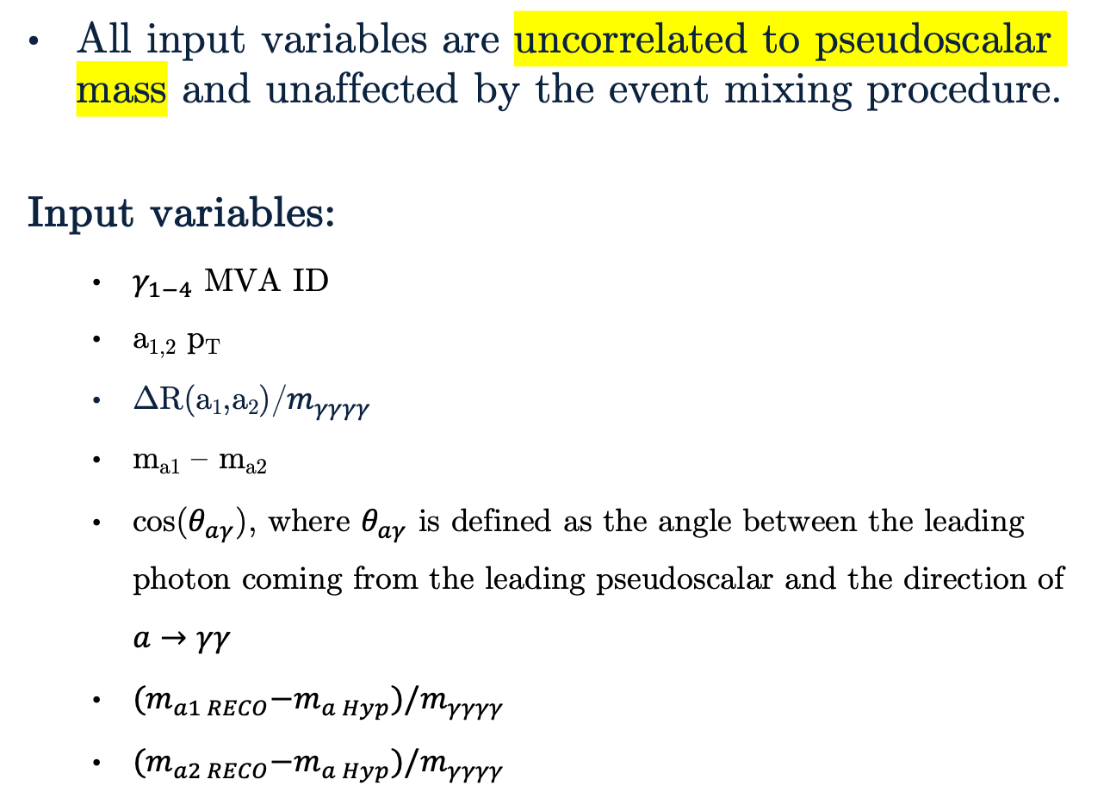
Input Variables
All input variables are uncorrelated to pseudoscalar mass and unaffected by the event mixing procedure.
Input variables:
$γ_{1−4}$ MVA ID
a_{1,2} p_{T}
ΔR(a₁,a₂)/$m_{γγγγ}$
m_{a1} – m_{a2}
cos($θ_{aγ}$), where $θ_{aγ}$ is defined as the angle between the leading photon coming from the leading pseudoscalar and the direction of $a→γγ$
${(m}_{a1 RECO}−m_{a Hyp})/m_{γγγγ}$
${(m}_{a2 RECO}−m_{a Hyp})/m_{γγγγ}$
Above: Chart of feature importance for the event selection BDT input variables from one of the best performing models.

Slide 17
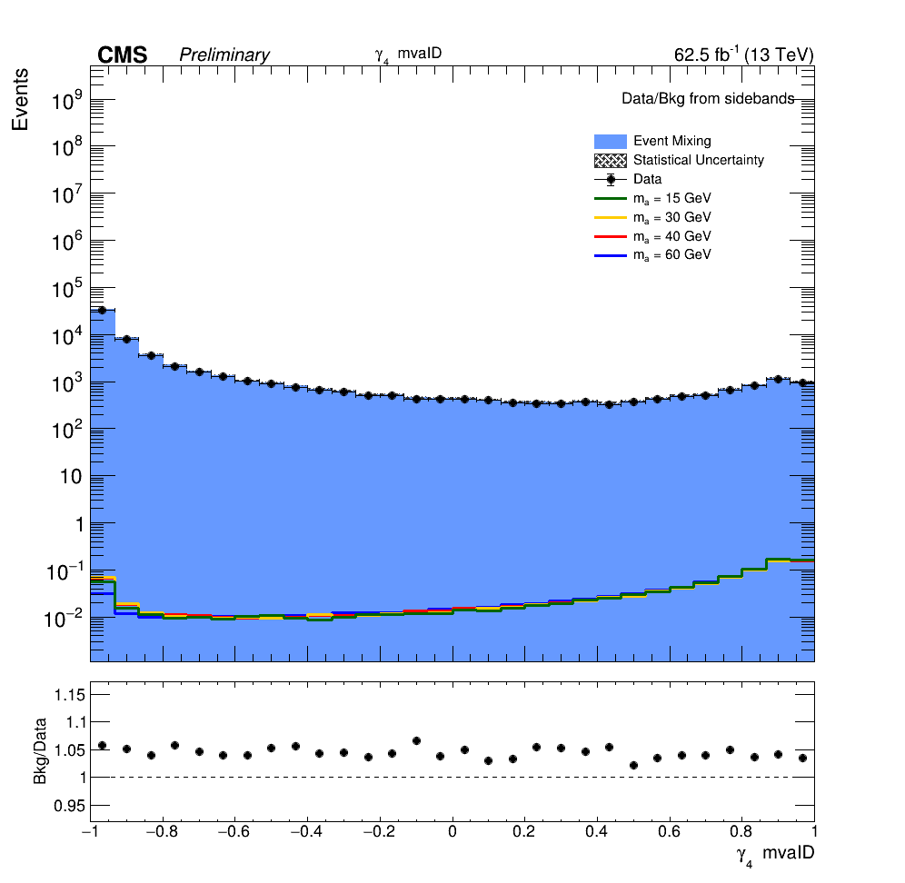
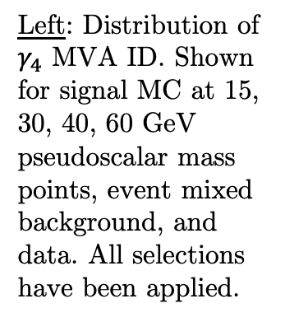
Important Input Variables
Left: Distribution of $γ_{4}$ MVA ID. Shown for signal MC at 15, 30, 40, 60 GeV pseudoscalar mass points, event mixed background, and data. All selections have been applied.
Above: Chart of feature importance for the event selection BDT input variables from one of the best performing models.

Slide 18
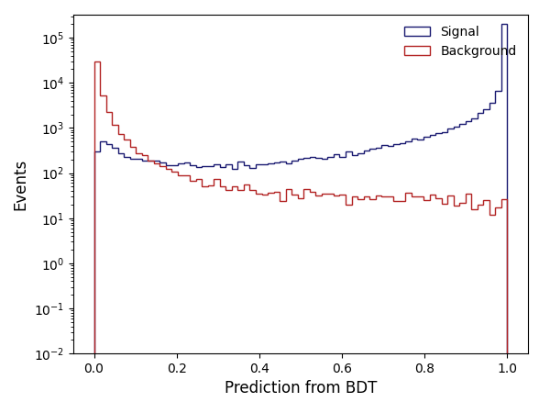
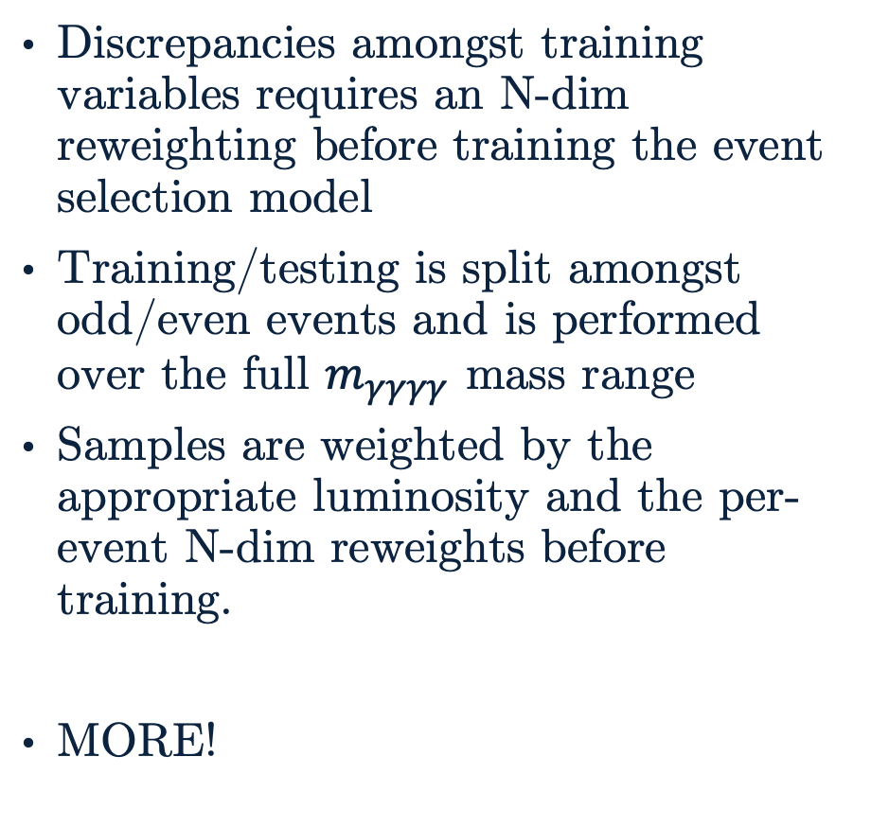
Training the Event Selection BDT
Discrepancies amongst training variables requires an N-dim reweighting before training the event selection model
Training/testing is split amongst odd/even events and is performed over the full $m_{γγγγ}$ mass range
Samples are weighted by the appropriate luminosity and the per-event N-dim reweights before training.
MORE!
Above: Event selection BDT predictions for training set using processed signal MC and event mixed background.

Slide 19
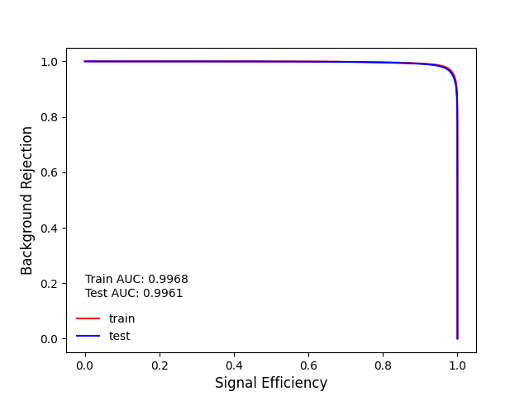
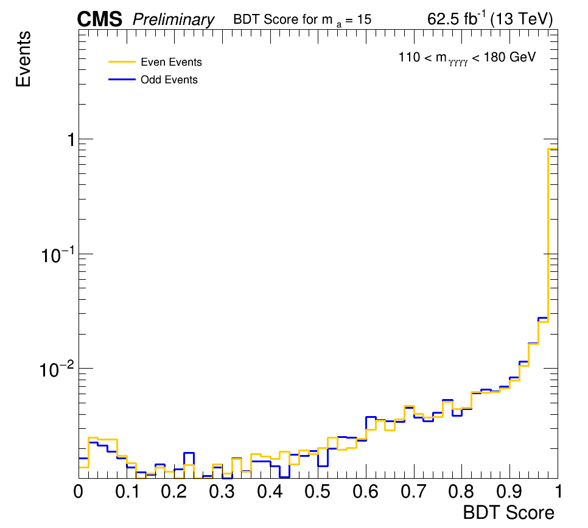
Checking the Event Selection BDT
Checks for overtraining are done to ensure an optimal event selection model is produced
ROC checks can be done for the entire model at once and even/odd checks must be done by nominal mass point
Above: ROC curve for the event selection BDT. A match between train/test curves and their associated area under curve (AUC) indicates a lack of overtraining.
Left: Overtraining check by comparing prediction distribution of trained event selection BDT model for m_{a} = 15 GeV. Odd/even (train/test) samples should have a similar distribution which would indicate a lack of overtraining.

Slide 20
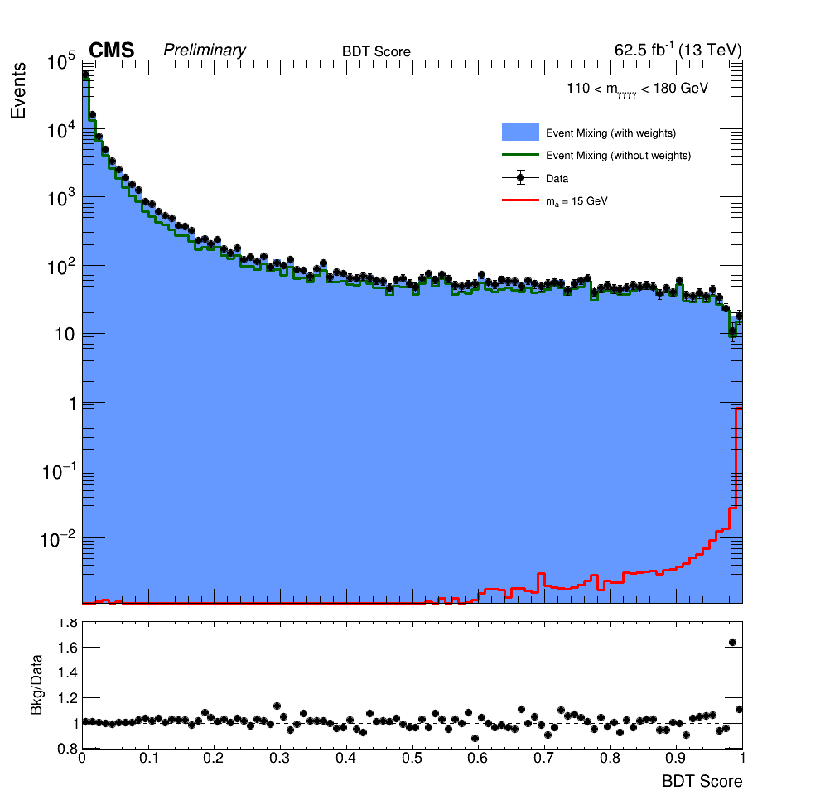
Event Selection BDT
Distribution of predictions – lead towards categorization

Slide 21
BDT Score Categorization
Categorization optimization + cut?
Talk about significance and the use of AMS
How the code works in backup???

Slide 22
Outline
The Standard Model and Beyond
LHC and CMS
Introduction to Analysis
Sample Generation
Event Selection
Statistical Analysis
Advancements on Previous Studies
Summary
Notes:
Introduction – what am I doing? Basic why is it interesting?
The Standard Model and Beyond – theory stuff
LHC and CMS – also mention service work here briefly
Sample Generation – signal MC and event mixing part
Event Selection – cuts, BDT, categorization
Statistical Analysis – signal modelling + note on background fits
Advancements on Previous Studies – exactly what it sounds like
Summary – put everything together for questions
REMEMBER TO INCLUDE PLOTS!!!!!!!

Slide 23
Statistical Analysis
Signal modelling for nominal mass points (plot(s)!)
Intermediate mass points – to do (talk about this?)
Note about background modelling as nuisance parameter when extracting limits? (Backup?)
To do stuff, e.g., limit extraction

Slide 24
Outline
The Standard Model and Beyond
LHC and CMS
Introduction to Analysis
Sample Generation
Event Selection
Statistical Analysis
Advancements on Previous Studies
Summary
Notes:
Introduction – what am I doing? Basic why is it interesting?
The Standard Model and Beyond – theory stuff
LHC and CMS – also mention service work here briefly
Sample Generation – signal MC and event mixing part
Event Selection – cuts, BDT, categorization
Statistical Analysis – signal modelling + note on background fits
Advancements on Previous Studies – exactly what it sounds like
Summary – put everything together for questions
REMEMBER TO INCLUDE PLOTS!!!!!!!

Slide 25
Advancements on Previous Studies
How to improve on the previous analysis…
More statistics if doing a Run 2 + partial Run 3
Deep learning model instead of a BDT (Keras network vs tree)
Better with lower-level variables. Still might be possible given the work done to add extra branches to the samples anyway
Improvement by sqrt(2) in precision from Run 2 → Run 3

Slide 26
Outline
The Standard Model and Beyond
LHC and CMS
Introduction to Analysis
Sample Generation
Event Selection
Statistical Analysis
Advancements on Previous Studies
Summary
Notes:
Introduction – what am I doing? Basic why is it interesting?
The Standard Model and Beyond – theory stuff
LHC and CMS – also mention service work here briefly
Sample Generation – signal MC and event mixing part
Event Selection – cuts, BDT, categorization
Statistical Analysis – signal modelling + note on background fits
Advancements on Previous Studies – exactly what it sounds like
Summary – put everything together for questions
REMEMBER TO INCLUDE PLOTS!!!!!!!

Slide 27
Summary
Do this last?

Slide 28
Thank You!

Slide 29
Backup

Slide 30
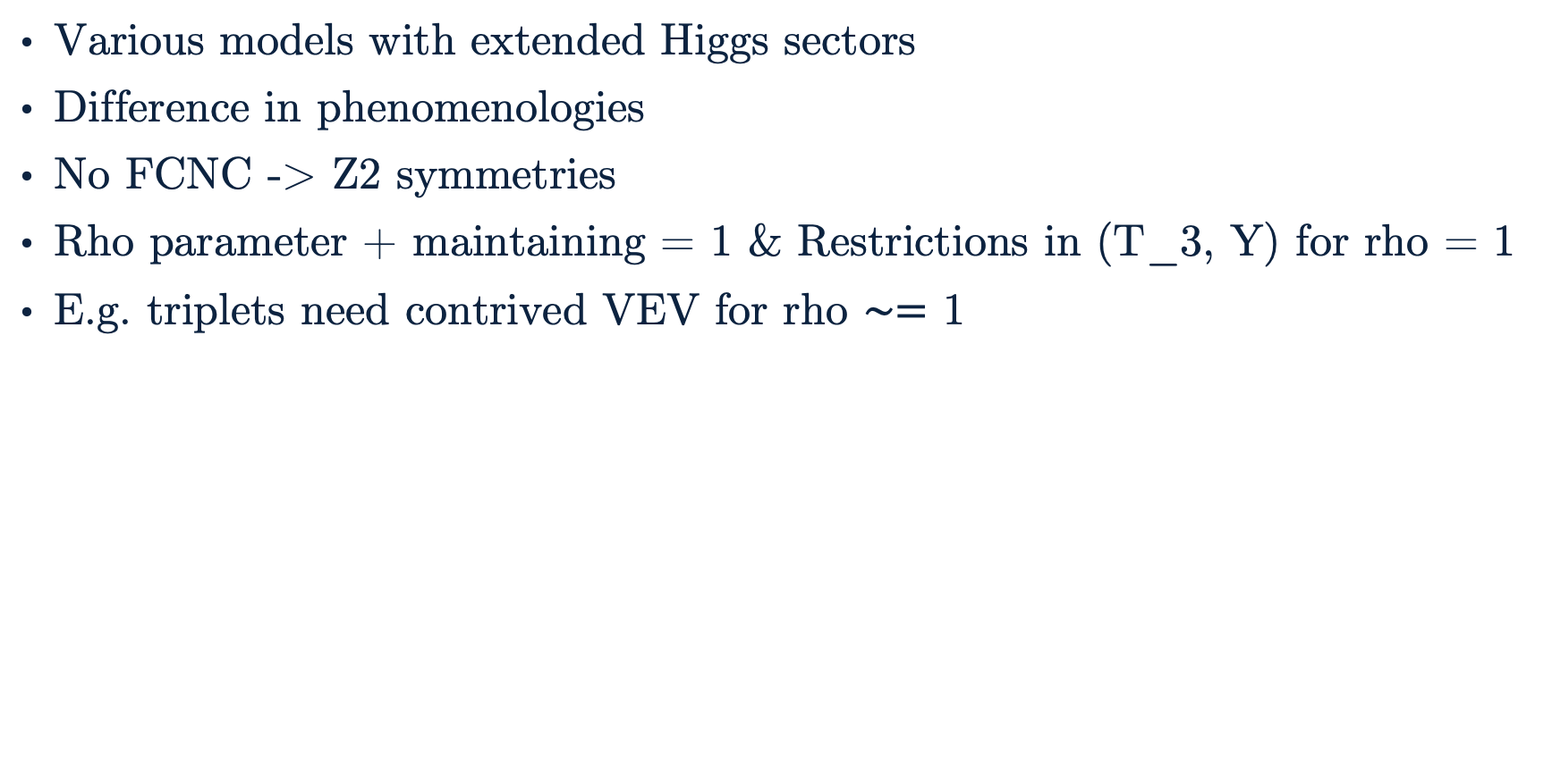
Extended Higgs Sectors
Various models with extended Higgs sectors
Difference in phenomenologies
No FCNC -> Z2 symmetries
Rho parameter + maintaining = 1 & Restrictions in (T_3, Y) for rho = 1
E.g. triplets need contrived VEV for rho $∼=$ 1

Slide 31
Backup Slide #1
Higgs mechanism and EWSB
Internal local symmetries of SM (alpha(point) varies. Not same for all space – that’s global symmetry)
Conversion of samples from miniAOD to nanoAOD
See yellow highlights for more backup slides!

